Slide 1
Chapter 10
Program Organization
*
Copyright © 2008 W. W. Norton & Company.
All rights reserved.

Slide 2
Local Variables
A variable declared in the body of a function is said to be local to the function:
int sum_digits(int n)
{
int sum = 0; /* local variable */
while (n > 0) {
sum += n % 10;
n /= 10;
}
return sum;
}
*
Copyright © 2008 W. W. Norton & Company.
All rights reserved.

Slide 3
Local Variables
Default properties of local variables:
Automatic storage duration. Storage is “automatically” allocated when the enclosing function is called and deallocated when the function returns.
Block scope. A local variable is visible from its point of declaration to the end of the enclosing function body.
*
Copyright © 2008 W. W. Norton & Company.
All rights reserved.

Slide 4
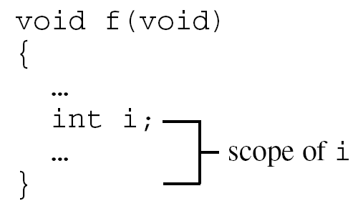
Local Variables
Since C99 doesn’t require variable declarations to come at the beginning of a function, it’s possible for a local variable to have a very small scope:
*
Copyright © 2008 W. W. Norton & Company.
All rights reserved.

Slide 5
Static Local Variables
Including static in the declaration of a local variable causes it to have static storage duration.
A variable with static storage duration has a permanent storage location, so it retains its value throughout the execution of the program.
Example:
void f(void)
{
static int i; /* static local variable */
…
}
A static local variable still has block scope, so it’s not visible to other functions.
*
Copyright © 2008 W. W. Norton & Company.
All rights reserved.

Slide 6
Parameters of functions
Parameters of a function have the same properties—automatic storage duration and block scope—as local variables.
Each parameter is initialized automatically when a function is called (by being assigned the value of the corresponding argument).
*
Copyright © 2008 W. W. Norton & Company.
All rights reserved.

Slide 7
External Variables
Passing arguments is one way to transmit information to a function.
Functions can also communicate through external variables—variables that are declared outside the body of any function.
External variables are sometimes known as global variables.
*
Copyright © 2008 W. W. Norton & Company.
All rights reserved.

Slide 8
External Variables
Properties of external variables:
Static storage duration
File scope
Having file scope means that an external variable is visible from its point of declaration to the end of the enclosing file.
*
Copyright © 2008 W. W. Norton & Company.
All rights reserved.

Slide 9
Example: Using External Variables to Implement a Stack
To illustrate how external variables might be used, let’s look at a data structure known as a stack.
A stack, like an array, can store multiple data items of the same type.
The operations on a stack are limited:
Push an item (add it to one end—the “stack top”)
Pop an item (remove it from the same end)
Examining or modifying an item that’s not at the top of the stack is forbidden.
*
Copyright © 2008 W. W. Norton & Company.
All rights reserved.

Slide 10
Example: Using External Variables to Implement a Stack
One way to implement a stack in C is to store its items in an array, which we’ll call contents.
A separate integer variable named top marks the position of the stack top.
When the stack is empty, top has the value 0.
To push an item: Store it in contents at the position indicated by top, then increment top.
To pop an item: Decrement top, then use it as an index into contents to fetch the item that’s being popped.
*
Copyright © 2008 W. W. Norton & Company.
All rights reserved.

Slide 11
Example: Using External Variables to Implement a Stack
The following program fragment declares the contents and top variables for a stack.
It also provides a set of functions that represent stack operations.
All five functions need access to the top variable, and two functions need access to contents, so contents and top will be external.
*
Copyright © 2008 W. W. Norton & Company.
All rights reserved.

Slide 12
Example: Using External Variables to Implement a Stack
#include <stdbool.h> /* C99 only */
#define STACK_SIZE 100
/* external variables */
int contents[STACK_SIZE];
int top = 0;
void make_empty(void)
{
top = 0;
}
bool is_empty(void)
{
return top == 0;
}
*
Copyright © 2008 W. W. Norton & Company.
All rights reserved.

Slide 13
Example: Using External Variables to Implement a Stack
bool is_full(void)
{
return top == STACK_SIZE;
}
void push(int i)
{
if (is_full()
stack_overflow();
else
contents[top++] = i;
}
int pop(void)
{
if (is_empty())
stack_underflow();
else
return contents[--top];
}
*
Copyright © 2008 W. W. Norton & Company.
All rights reserved.

Slide 14
Pros and Cons of External Variables
External variables are convenient when many functions must share a variable or when a few functions share a large number of variables.
In most cases, it’s better for functions to communicate through parameters rather than by sharing variables:
If we change an external variable during program maintenance (by altering its type, say), we’ll need to check every function in the same file to see how the change affects it.
If an external variable is assigned an incorrect value, it may be difficult to identify the guilty function.
Functions that rely on external variables are hard to reuse in other programs.
*
Copyright © 2008 W. W. Norton & Company.
All rights reserved.

Slide 15
Pros and Cons of External Variables
Don’t use the same external variable for different purposes in different functions.
Suppose that several functions need a variable named i to control a for statement.
Instead of declaring i in each function that uses it, some programmers declare it just once at the top of the program.
This practice is misleading; someone reading the program later may think that the uses of i are related, when in fact they’re not.
*
Copyright © 2008 W. W. Norton & Company.
All rights reserved.

Slide 16
Pros and Cons of External Variables
Make sure that external variables have meaningful names.
Local variables don’t always need meaningful names: it’s often hard to think of a better name than i for the control variable in a for loop.
*
Copyright © 2008 W. W. Norton & Company.
All rights reserved.

Slide 17
Pros and Cons of External Variables
Making variables external when they should be local can lead to some rather frustrating bugs.
Code that is supposed to display a 10 × 10 arrangement of asterisks:
int i;
void print_one_row(void)
{
for (i = 1; i <= 10; i++)
printf("*");
}
void print_all_rows(void)
{
for (i = 1; i <= 10; i++) {
print_one_row();
printf("\n");
}
}
Instead of printing 10 rows, print_all_rows prints only one.
*
Copyright © 2008 W. W. Norton & Company.
All rights reserved.

Slide 18
Program: Guessing a Number
The guess.c program generates a random number between 1 and 100, which the user attempts to guess in as few tries as possible:
Guess the secret number between 1 and 100.
A new number has been chosen.
Enter guess: 55
Too low; try again.
Enter guess: 65
Too high; try again.
Enter guess: 60
Too high; try again.
Enter guess: 58
You won in 4 guesses!
*
Copyright © 2008 W. W. Norton & Company.
All rights reserved.

Slide 19
Program: Guessing a Number
Play again? (Y/N) y
A new number has been chosen.
Enter guess: 78
Too high; try again.
Enter guess: 34
You won in 2 guesses!
Play again? (Y/N) n
Tasks to be carried out by the program:
Initialize the random number generator
Choose a secret number
Interact with the user until the correct number is picked
Each task can be handled by a separate function.
*
Copyright © 2008 W. W. Norton & Company.
All rights reserved.

Slide 20
guess.c
/* Asks user to guess a hidden number */
#include <stdio.h>
#include <stdlib.h>
#include <time.h>
#define MAX_NUMBER 100
/* external variable */
int secret_number;
/* prototypes */
void initialize_number_generator(void);
void choose_new_secret_number(void);
void read_guesses(void);
*
Copyright © 2008 W. W. Norton & Company.
All rights reserved.

Slide 21
int main(void)
{
char command;
printf("Guess the secret number between 1 and %d.\n\n",
MAX_NUMBER);
initialize_number_generator();
do {
choose_new_secret_number();
printf("A new number has been chosen.\n");
read_guesses();
printf("Play again? (Y/N) ");
scanf(" %c", &command);
printf("\n");
} while (command == 'y' || command == 'Y');
return 0;
}
*
Copyright © 2008 W. W. Norton & Company.
All rights reserved.

Slide 22
/**********************************************************
* initialize_number_generator: Initializes the random *
* number generator using *
* the time of day. *
**********************************************************/
void initialize_number_generator(void)
{
srand((unsigned) time(NULL));
}
/**********************************************************
* choose_new_secret_number: Randomly selects a number *
* between 1 and MAX_NUMBER and *
* stores it in secret_number. *
**********************************************************/
void choose_new_secret_number(void)
{
secret_number = rand() % MAX_NUMBER + 1;
}
*
Copyright © 2008 W. W. Norton & Company.
All rights reserved.

Slide 23
/**********************************************************
* read_guesses: Repeatedly reads user guesses and tells *
* the user whether each guess is too low, *
* too high, or correct. When the guess is *
* correct, prints the total number of *
* guesses and returns. *
**********************************************************/
void read_guesses(void)
{
int guess, num_guesses = 0;
for (;;) {
num_guesses++;
printf("Enter guess: ");
scanf("%d", &guess);
if (guess == secret_number) {
printf("You won in %d guesses!\n\n", num_guesses);
return;
} else if (guess < secret_number)
printf("Too low; try again.\n");
else
printf("Too high; try again.\n");
}
}
*
Copyright © 2008 W. W. Norton & Company.
All rights reserved.

Slide 24
Program: Guessing a Number
Although guess.c works fine, it relies on the external variable secret_number.
By altering choose_new_secret_number and read_guesses slightly, we can move secret_number into the main function.
The new version of guess.c follows, with changes in bold.
*
Copyright © 2008 W. W. Norton & Company.
All rights reserved.

Slide 25
guess2.c
/* Asks user to guess a hidden number */
#include <stdio.h>
#include <stdlib.h>
#include <time.h>
#define MAX_NUMBER 100
/* prototypes */
void initialize_number_generator(void);
int new_secret_number(void);
void read_guesses(int secret_number);
*
Copyright © 2008 W. W. Norton & Company.
All rights reserved.

Slide 26
int main(void)
{
char command;
int secret_number;
printf("Guess the secret number between 1 and %d.\n\n",
MAX_NUMBER);
initialize_number_generator();
do {
secret_number = new_secret_number();
printf("A new number has been chosen.\n");
read_guesses(secret_number);
printf("Play again? (Y/N) ");
scanf(" %c", &command);
printf("\n");
} while (command == 'y' || command == 'Y');
return 0;
}
*
Copyright © 2008 W. W. Norton & Company.
All rights reserved.

Slide 27
/**********************************************************
* initialize_number_generator: Initializes the random *
* number generator using *
* the time of day. *
**********************************************************/
void initialize_number_generator(void)
{
srand((unsigned) time(NULL));
}
/**********************************************************
* new_secret_number: Returns a randomly chosen number *
* between 1 and MAX_NUMBER. *
**********************************************************/
int new_secret_number(void)
{
return rand() % MAX_NUMBER + 1;
}
*
Copyright © 2008 W. W. Norton & Company.
All rights reserved.

Slide 28
/**********************************************************
* read_guesses: Repeatedly reads user guesses and tells *
* the user whether each guess is too low, *
* too high, or correct. When the guess is *
* correct, prints the total number of *
* guesses and returns. *
**********************************************************/
void read_guesses(int secret_number)
{
int guess, num_guesses = 0;
for (;;) {
num_guesses++;
printf("Enter guess: ");
scanf("%d", &guess);
if (guess == secret_number) {
printf("You won in %d guesses!\n\n", num_guesses);
return;
} else if (guess < secret_number)
printf("Too low; try again.\n");
else
printf("Too high; try again.\n");
}
}
*
Copyright © 2008 W. W. Norton & Company.
All rights reserved.

Slide 29
Blocks
In Section 5.2, we encountered compound statements of the form
{ statements }
C allows compound statements to contain declarations as well as statements:
{ declarations statements }
This kind of compound statement is called a block.
*
Copyright © 2008 W. W. Norton & Company.
All rights reserved.

Slide 30
Blocks
Example of a block:
if (i > j) {
/* swap values of i and j */
int temp = i;
i = j;
j = temp;
}
*
Copyright © 2008 W. W. Norton & Company.
All rights reserved.

Slide 31
Blocks
By default, the storage duration of a variable declared in a block is automatic: storage for the variable is allocated when the block is entered and deallocated when the block is exited.
The variable has block scope; it can’t be referenced outside the block.
A variable that belongs to a block can be declared static to give it static storage duration.
*
Copyright © 2008 W. W. Norton & Company.
All rights reserved.

Slide 32
Blocks
The body of a function is a block.
Blocks are also useful inside a function body when we need variables for temporary use.
Advantages of declaring temporary variables in blocks:
Avoids cluttering declarations at the beginning of the function body with variables that are used only briefly.
Reduces name conflicts.
C99 allows variables to be declared anywhere within a block.
*
Copyright © 2008 W. W. Norton & Company.
All rights reserved.

Slide 33
Scope
In a C program, the same identifier may have several different meanings.
C’s scope rules enable the programmer (and the compiler) to determine which meaning is relevant at a given point in the program.
The most important scope rule: When a declaration inside a block names an identifier that’s already visible, the new declaration temporarily “hides” the old one, and the identifier takes on a new meaning.
At the end of the block, the identifier regains its old meaning.
*
Copyright © 2008 W. W. Norton & Company.
All rights reserved.

Slide 34
Scope
In the example on the next slide, the identifier i has four different meanings:
In Declaration 1, i is a variable with static storage duration and file scope.
In Declaration 2, i is a parameter with block scope.
In Declaration 3, i is an automatic variable with block scope.
In Declaration 4, i is also automatic and has block scope.
C’s scope rules allow us to determine the meaning of i each time it’s used (indicated by arrows).
*
Copyright © 2008 W. W. Norton & Company.
All rights reserved.

Slide 35
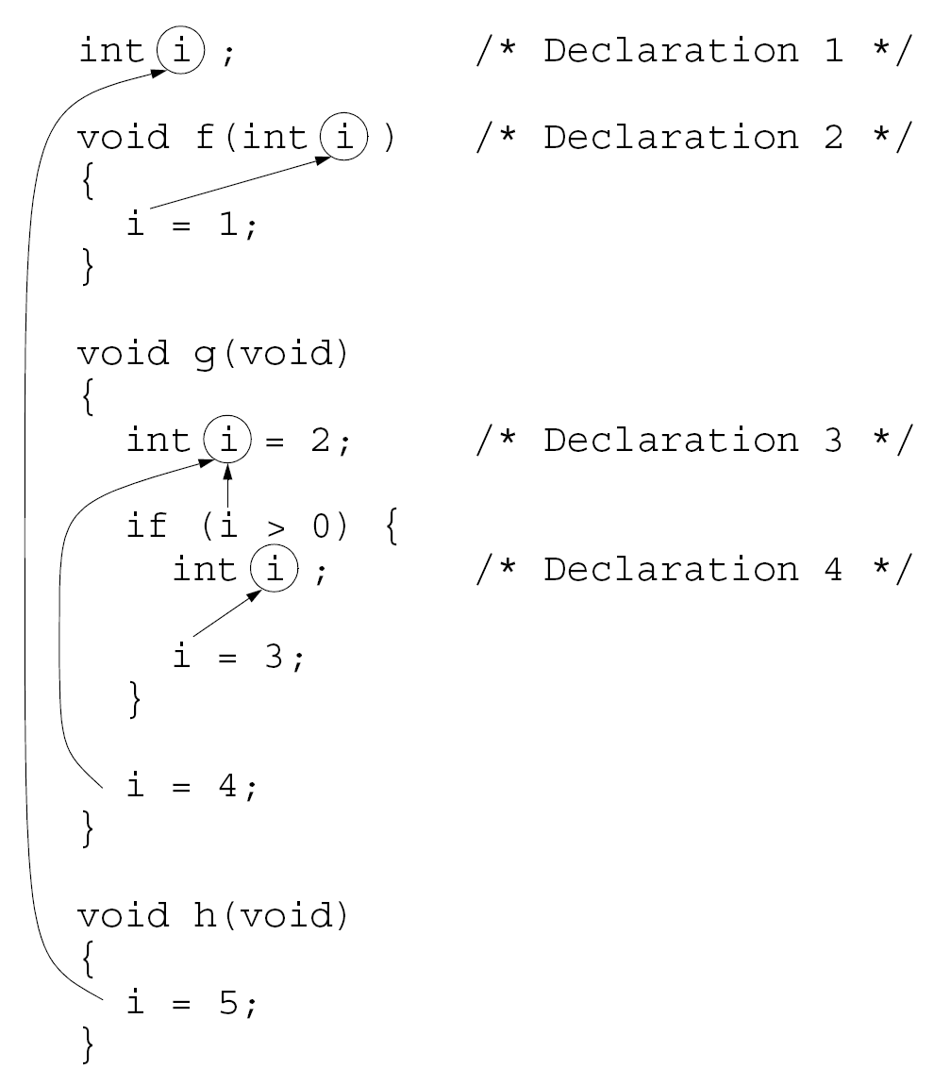
*
Copyright © 2008 W. W. Norton & Company.
All rights reserved.

Slide 36
Organizing a C Program
Major elements of a C program:
Preprocessing directives such as #include and #define
Type definitions
Declarations of external variables
Function prototypes
Function definitions
*
Copyright © 2008 W. W. Norton & Company.
All rights reserved.

Slide 37
Organizing a C Program
C imposes only a few rules on the order of these items:
A preprocessing directive doesn’t take effect until the line on which it appears.
A type name can’t be used until it’s been defined.
A variable can’t be used until it’s declared.
It’s a good idea to define or declare every function prior to its first call.
C99 makes this a requirement.
*
Copyright © 2008 W. W. Norton & Company.
All rights reserved.

Slide 38
Organizing a C Program
There are several ways to organize a program so that these rules are obeyed.
One possible ordering:
#include directives
#define directives
Type definitions
Declarations of external variables
Prototypes for functions other than main
Definition of main
Definitions of other functions
*
Copyright © 2008 W. W. Norton & Company.
All rights reserved.

Slide 39
Organizing a C Program
It’s a good idea to have a boxed comment preceding each function definition.
Information to include in the comment:
Name of the function
Purpose of the function
Meaning of each parameter
Description of return value (if any)
Description of side effects (such as modifying external variables)
*
Copyright © 2008 W. W. Norton & Company.
All rights reserved.

Slide 40
Program: Classifying a Poker Hand
The poker.c program will classify a poker hand.
Each card in the hand has a suit and a rank.
Suits: clubs, diamonds, hearts, spades
Ranks: two, three, four, five, six, seven, eight, nine, ten, jack, queen, king, ace
Jokers are not allowed, and aces are high.
After reading a hand of five cards, the program will classify the hand using the categories on the next slide.
If a hand falls into two or more categories, the program will choose the best one.
*
Copyright © 2008 W. W. Norton & Company.
All rights reserved.

Slide 41
Program: Classifying a Poker Hand
Categories (listed from best to worst):
straight flush (both a straight and a flush)
four-of-a-kind (four cards of the same rank)
full house (a three-of-a-kind and a pair)
flush (five cards of the same suit)
straight (five cards with consecutive ranks)
three-of-a-kind (three cards of the same rank)
two pairs
pair (two cards of the same rank)
high card (any other hand)
*
Copyright © 2008 W. W. Norton & Company.
All rights reserved.

Slide 42
Program: Classifying a Poker Hand
For input purposes, ranks and suits will be single letters (upper- or lower-case):
Ranks: 2 3 4 5 6 7 8 9 t j q k a
Suits: c d h s
Actions to be taken if the user enters an illegal card or tries to enter the same card twice:
Ignore the card
Issue an error message
Request another card
Entering the number 0 instead of a card will cause the program to terminate.
*
Copyright © 2008 W. W. Norton & Company.
All rights reserved.

Slide 43
Program: Classifying a Poker Hand
A sample session with the program:
Enter a card: 2s
Enter a card: 5s
Enter a card: 4s
Enter a card: 3s
Enter a card: 6s
Straight flush
*
Copyright © 2008 W. W. Norton & Company.
All rights reserved.

Slide 44
Program: Classifying a Poker Hand
Enter a card: 8c
Enter a card: as
Enter a card: 8c
Duplicate card; ignored.
Enter a card: 7c
Enter a card: ad
Enter a card: 3h
Pair
*
Copyright © 2008 W. W. Norton & Company.
All rights reserved.

Slide 45
Program: Classifying a Poker Hand
Enter a card: 6s
Enter a card: d2
Bad card; ignored.
Enter a card: 2d
Enter a card: 9c
Enter a card: 4h
Enter a card: ts
High card
Enter a card: 0
*
Copyright © 2008 W. W. Norton & Company.
All rights reserved.

Slide 46
Program: Classifying a Poker Hand
The program has three tasks:
Read a hand of five cards
Analyze the hand for pairs, straights, and so forth
Print the classification of the hand
The functions read_cards, analyze_hand, and print_result will perform these tasks.
main does nothing but call these functions inside an endless loop.
*
Copyright © 2008 W. W. Norton & Company.
All rights reserved.

Slide 47
Program: Classifying a Poker Hand
The functions will need to share a fairly large amount of information, so we’ll have them communicate through external variables.
read_cards will store information about the hand into several external variables.
analyze_hand will then examine these variables, storing its findings into other external variables for the benefit of print_result.
*
Copyright © 2008 W. W. Norton & Company.
All rights reserved.

Slide 48
Program: Classifying a Poker Hand
Program outline:
/* #include directives go here */
/* #define directives go here */
/* declarations of external variables go here */
/* prototypes */
void read_cards(void);
void analyze_hand(void);
void print_result(void);
*
Copyright © 2008 W. W. Norton & Company.
All rights reserved.

Slide 49
Program: Classifying a Poker Hand
/**********************************************************
* main: Calls read_cards, analyze_hand, and print_result *
* repeatedly. *
**********************************************************/
int main(void)
{
for (;;) {
read_cards();
analyze_hand();
print_result();
}
}
/**********************************************************
* read_cards: Reads the cards into external variables; *
* checks for bad cards and duplicate cards. *
**********************************************************/
void read_cards(void)
{
…
}
*
Copyright © 2008 W. W. Norton & Company.
All rights reserved.

Slide 50
Program: Classifying a Poker Hand
/**********************************************************
* analyze_hand: Determines whether the hand contains a *
* straight, a flush, four-of-a-kind, *
* and/or three-of-a-kind; determines the *
* number of pairs; stores the results into *
* external variables. *
**********************************************************/
void analyze_hand(void)
{
…
}
/**********************************************************
* print_result: Notifies the user of the result, using *
* the external variables set by *
* analyze_hand. *
**********************************************************/
void print_result(void)
{
…
}
*
Copyright © 2008 W. W. Norton & Company.
All rights reserved.

Slide 51
Program: Classifying a Poker Hand
How should we represent the hand of cards?
analyze_hand will need to know how many cards are in each rank and each suit.
This suggests that we use two arrays, num_in_rank and num_in_suit.
num_in_rank[r] will be the number of cards with rank r.
num_in_suit[s] will be the number of cards with suit s.
We’ll encode ranks as numbers between 0 and 12.
Suits will be numbers between 0 and 3.
*
Copyright © 2008 W. W. Norton & Company.
All rights reserved.

Slide 52
Program: Classifying a Poker Hand
We’ll also need a third array, card_exists, so that read_cards can detect duplicate cards.
Each time read_cards reads a card with rank r and suit s, it checks whether the value of card_exists[r][s] is true.
If so, the card was previously entered.
If not, read_cards assigns true to card_exists[r][s].
*
Copyright © 2008 W. W. Norton & Company.
All rights reserved.

Slide 53
Program: Classifying a Poker Hand
Both the read_cards function and the analyze_hand function will need access to the num_in_rank and num_in_suit arrays, so they will be external variables.
The card_exists array is used only by read_cards, so it can be local to that function.
As a rule, variables should be made external only if necessary.
*
Copyright © 2008 W. W. Norton & Company.
All rights reserved.

Slide 54
poker.c
/* Classifies a poker hand */
#include <stdbool.h> /* C99 only */
#include <stdio.h>
#include <stdlib.h>
#define NUM_RANKS 13
#define NUM_SUITS 4
#define NUM_CARDS 5
/* external variables */
int num_in_rank[NUM_RANKS];
int num_in_suit[NUM_SUITS];
bool straight, flush, four, three;
int pairs; /* can be 0, 1, or 2 */
*
Copyright © 2008 W. W. Norton & Company.
All rights reserved.

Slide 55
/* prototypes */
void read_cards(void);
void analyze_hand(void);
void print_result(void);
/**********************************************************
* main: Calls read_cards, analyze_hand, and print_result *
* repeatedly. *
**********************************************************/
int main(void)
{
for (;;) {
read_cards();
analyze_hand();
print_result();
}
}
*
Copyright © 2008 W. W. Norton & Company.
All rights reserved.

Slide 56
/**********************************************************
* read_cards: Reads the cards into the external *
* variables num_in_rank and num_in_suit; *
* checks for bad cards and duplicate cards. *
**********************************************************/
void read_cards(void)
{
bool card_exists[NUM_RANKS][NUM_SUITS];
char ch, rank_ch, suit_ch;
int rank, suit;
bool bad_card;
int cards_read = 0;
for (rank = 0; rank < NUM_RANKS; rank++) {
num_in_rank[rank] = 0;
for (suit = 0; suit < NUM_SUITS; suit++)
card_exists[rank][suit] = false;
}
for (suit = 0; suit < NUM_SUITS; suit++)
num_in_suit[suit] = 0;
*
Copyright © 2008 W. W. Norton & Company.
All rights reserved.

Slide 57
while (cards_read < NUM_CARDS) {
bad_card = false;
printf("Enter a card: ");
rank_ch = getchar();
switch (rank_ch) {
case '0': exit(EXIT_SUCCESS);
case '2': rank = 0; break;
case '3': rank = 1; break;
case '4': rank = 2; break;
case '5': rank = 3; break;
case '6': rank = 4; break;
case '7': rank = 5; break;
case '8': rank = 6; break;
case '9': rank = 7; break;
case 't': case 'T': rank = 8; break;
case 'j': case 'J': rank = 9; break;
case 'q': case 'Q': rank = 10; break;
case 'k': case 'K': rank = 11; break;
case 'a': case 'A': rank = 12; break;
default: bad_card = true;
}
*
Copyright © 2008 W. W. Norton & Company.
All rights reserved.

Slide 58
suit_ch = getchar();
switch (suit_ch) {
case 'c': case 'C': suit = 0; break;
case 'd': case 'D': suit = 1; break;
case 'h': case 'H': suit = 2; break;
case 's': case 'S': suit = 3; break;
default: bad_card = true;
}
while ((ch = getchar()) != '\n')
if (ch != ' ') bad_card = true;
if (bad_card)
printf("Bad card; ignored.\n");
else if (card_exists[rank][suit])
printf("Duplicate card; ignored.\n");
else {
num_in_rank[rank]++;
num_in_suit[suit]++;
card_exists[rank][suit] = true;
cards_read++;
}
}// end for while (cards_read < NUM_CARDS) {
}//end function read_cards(void)
*
Copyright © 2008 W. W. Norton & Company.
All rights reserved.

Slide 59
/**********************************************************
* analyze_hand: Determines whether the hand contains a *
* straight, a flush, four-of-a-kind, *
* and/or three-of-a-kind; determines the *
* number of pairs; stores the results into *
* the external variables straight, flush, *
* four, three, and pairs. *
**********************************************************/
void analyze_hand(void)
{
int num_consec = 0;
int rank, suit;
straight = false;
flush = false;
four = false;
three = false;
pairs = 0;
*
Copyright © 2008 W. W. Norton & Company.
All rights reserved.

Slide 60
/* check for flush */
for (suit = 0; suit < NUM_SUITS; suit++)
if (num_in_suit[suit] == NUM_CARDS)
flush = true;
/* check for straight */
rank = 0;
while (num_in_rank[rank] == 0) rank++;
for (; rank < NUM_RANKS && num_in_rank[rank] > 0; rank++)
num_consec++;
if (num_consec == NUM_CARDS) {
straight = true;
return;
}
/* check for 4-of-a-kind, 3-of-a-kind, and pairs */
for (rank = 0; rank < NUM_RANKS; rank++) {
if (num_in_rank[rank] == 4) four = true;
if (num_in_rank[rank] == 3) three = true;
if (num_in_rank[rank] == 2) pairs++;
}
}
*
Copyright © 2008 W. W. Norton & Company.
All rights reserved.

Slide 61
/**********************************************************
* print_result: Prints the classification of the hand, *
* based on the values of the external *
* variables straight, flush, four, three, *
* and pairs. *
**********************************************************/
void print_result(void)
{
if (straight && flush) printf("Straight flush");
else if (four) printf("Four of a kind");
else if (three &&
pairs == 1) printf("Full house");
else if (flush) printf("Flush");
else if (straight) printf("Straight");
else if (three) printf("Three of a kind");
else if (pairs == 2) printf("Two pairs");
else if (pairs == 1) printf("Pair");
else printf("High card");
printf("\n\n");
}
*
Copyright © 2008 W. W. Norton & Company.
All rights reserved.

Slide 62
A pseudo random number generator is used. Four different ways are given as follows.
Which method(s) will give correct results? Also explain the differences between them. #define INITIAL_SEED 17
#define MULTIPLIER 25173
#define INCREMENT 13849
#define MODULUS 65536
static unsigned seed=INITIAL_SEED;
unsigned random(void)
{ seed = (MULTIPLIER * seed + INCREMENT) % MODULUS;
return seed;
}
(1) ...
unsigned seed=INITIAL_SEED;
unsigned random(void)
{ seed = (MULTIPLIER * seed + INCREMENT) % MODULUS;
return seed; }
*
Copyright © 2008 W. W. Norton & Company.
All rights reserved.

Slide 63
(2)
...
unsigned random(void)
{ static unsigned seed=INITIAL_SEED;
seed = (MULTIPLIER * seed + INCREMENT) % MODULUS;
return seed; }
(3)
...
unsigned random(void)
{ unsigned seed=INITIAL_SEED;
seed = (MULTIPLIER * seed + INCREMENT) % MODULUS;
return seed; }
*
Copyright © 2008 W. W. Norton & Company.
All rights reserved.

